Slide 1
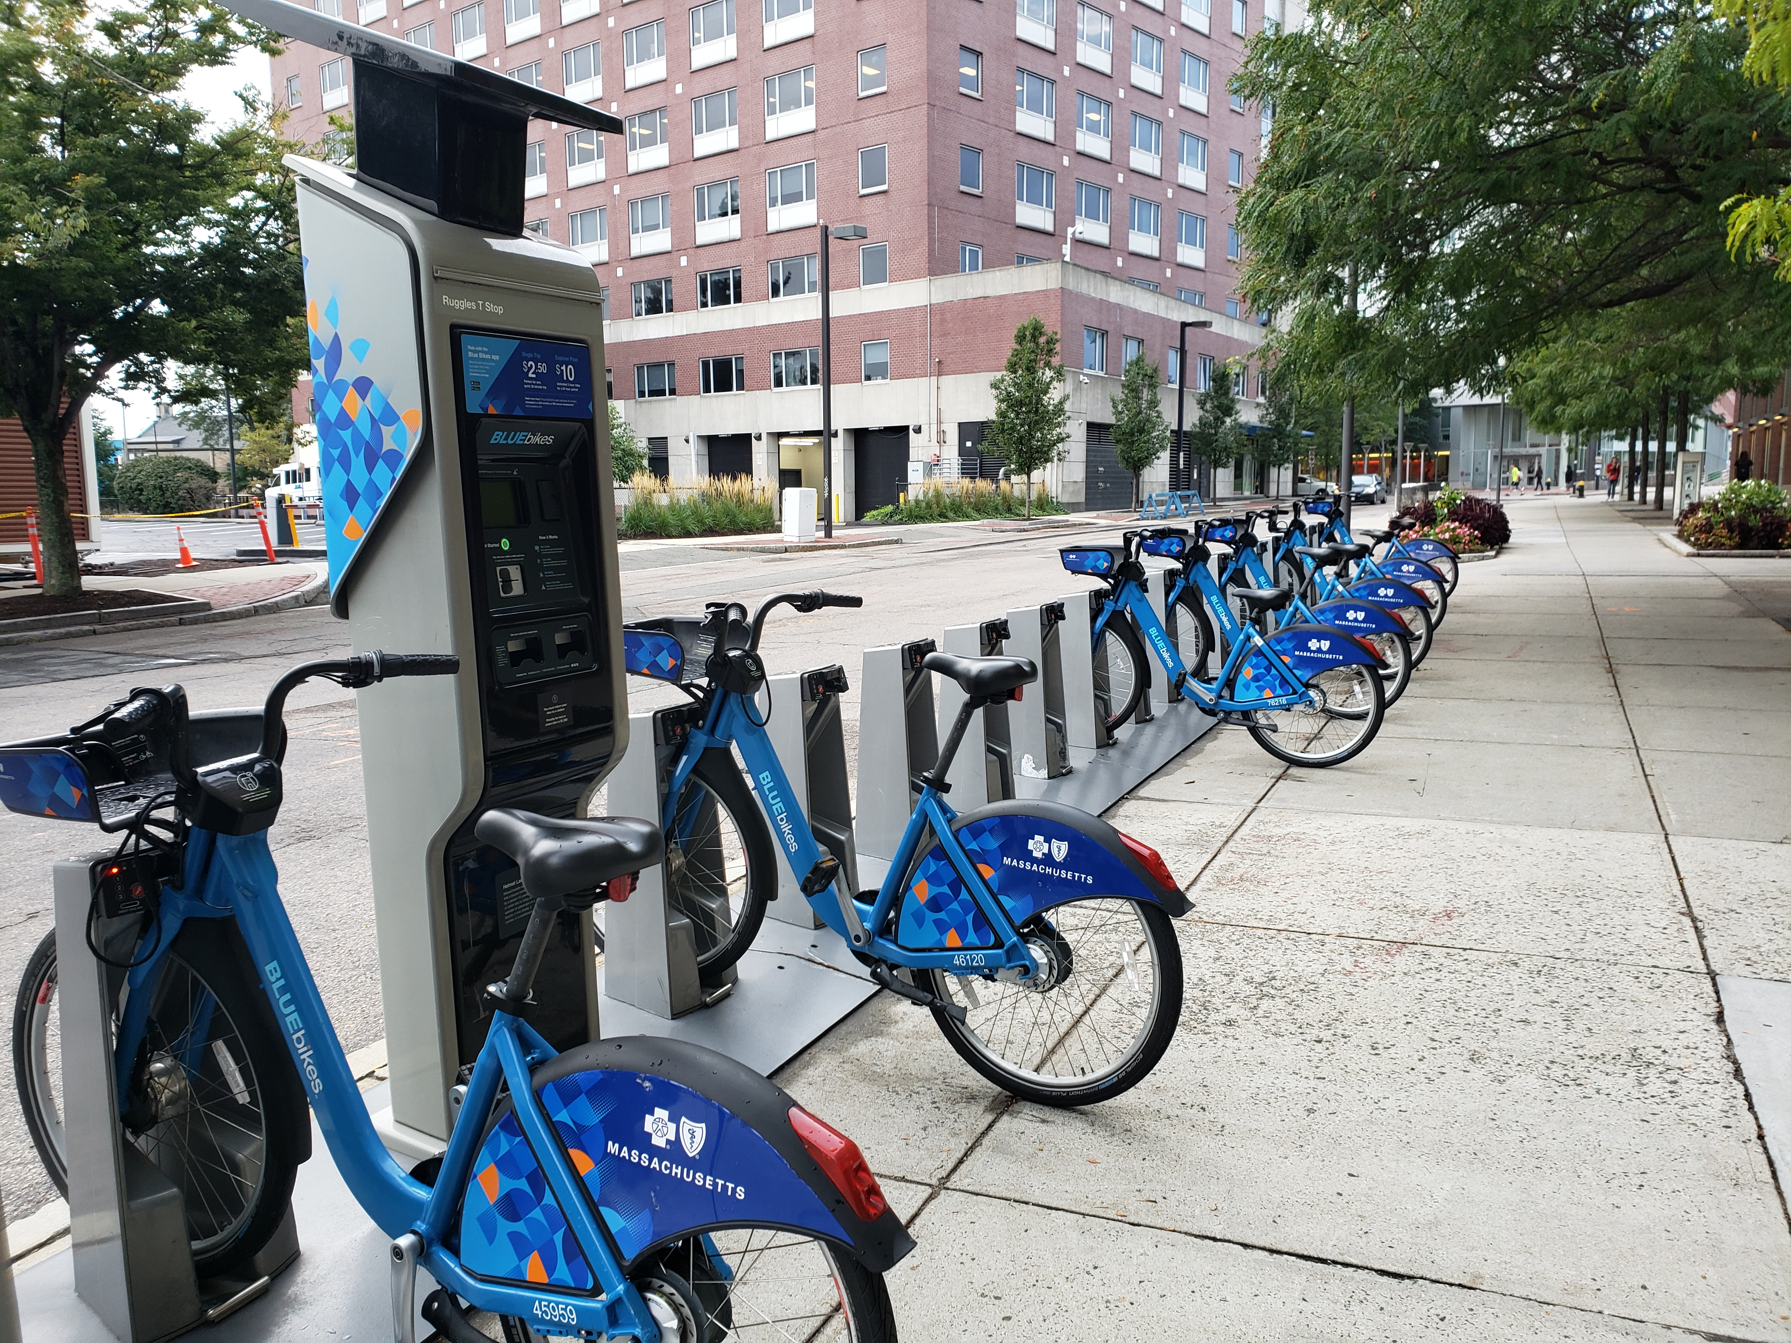
Bluebikes Urban Mobility Analysis

Slide 2
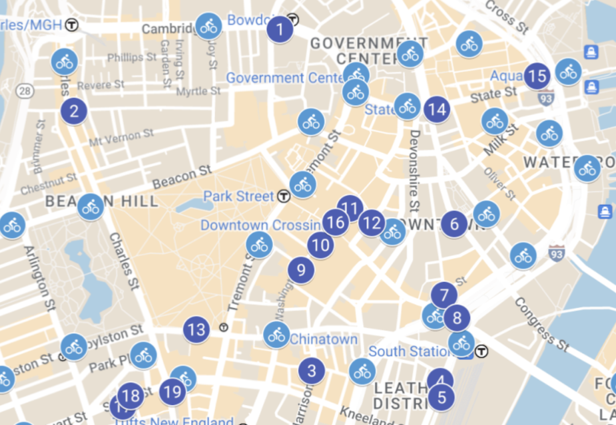
Big Idea & Data Overview
“By optimizing Bluebikes demand, Boston can cut urban congestion by 15% while boosting sustainable transportation adoption”
Boston’s growing congestion challenges highlight the need for smarter, more sustainable commuting options. With nearly 100,000 Bluebikes trips recorded in 2023–2024, we saw an opportunity to use real rider behavior to uncover how and when people use the system, what drives sustainable adoption, and which stations and routes shape the network’s performance. The insights from this analysis will guide us through peak demand patterns, sustainability behaviors, and strategic station planning—setting the stage for actionable recommendations to improve Boston’s urban mobility.
Dataset Snapshot:
Dataset Snapshot: 📊 Records: 98,382 individual Bluebikes trips analyzed 📍 Coverage: Greater Boston area, 2023–2024 period ⏱️ Features: Trip start and end times, duration, and locations 👥 User Types: Members vs. casual riders 🌍 Source: Bluebikes Open Data Portal
““Next, we’ll see how this data reveals Boston’s peak demand patterns and commuting behavior.”

Slide 3
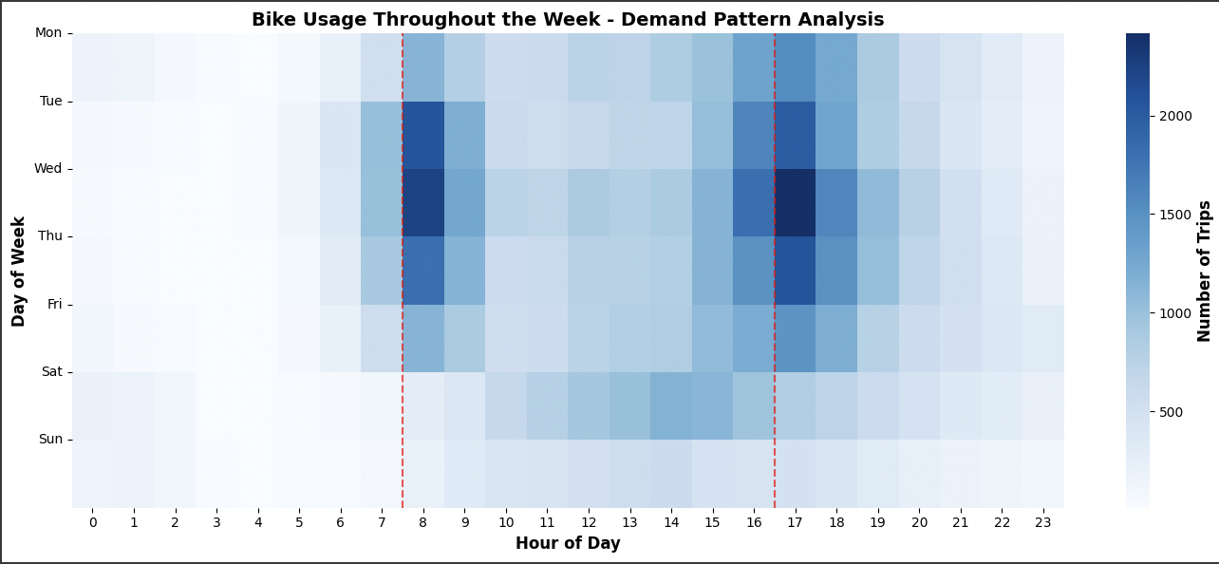
How can we identify and optimize high-demand periods to reduce congestion?
Building on our dataset, our first goal was to understand when Boston’s Bluebikes network experiences its highest pressure.
Hourly usage heatmap showing day-by-day demand patterns across the week
🗓️ Weekday dominance: Highest activity observed during weekdays, confirming strong commuter-driven usage.
⏰ Dual peak pattern: Clear morning (7–9 AM) and evening (5–7 PM) rush-hour peaks.
🌅 Evening surge: Evening peak consistently higher, showing heavier return-commute demand.
🎡 Weekend contrast: Weekend rides spread evenly through the day, reflecting leisure-focused trips.

Slide 4
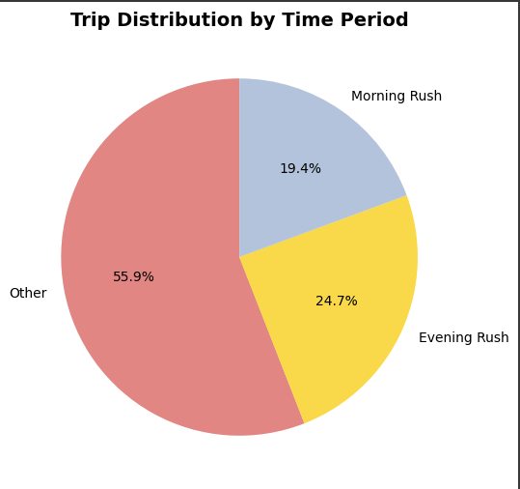
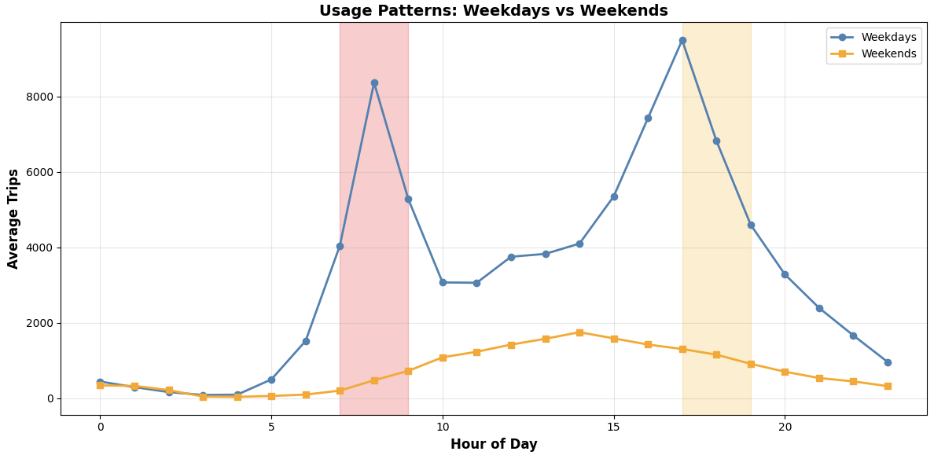
Peak Demand Analysis
Visualizing Peak Usage Trends in Urban Bike-Sharing Systems
Key Findings
Morning rush (7–9 AM): 19,069 trips (19.4 %)
Evening rush (5–7 PM): 24,277 trips (24.7 %)
Combined rush hours: 44.1 % of all trips
Peak usage hour: 17:00 (5 PM)
Most popular route: Central Sq → MIT Pacific St (239 trips)
Average trip duration: 10.9 min (rush) vs 10.7 min (off-peak)
Recommendations – Peak Demand Optimization
Expand capacity by ~40 % during 7–9 AM and 5–7 PM rush hours.
Prioritize top 10 routes for infrastructure upgrades and rebalancing.
Introduce off-peak pricing to shift discretionary trips away from rush hours.
Use dynamic redistribution to ensure bike availability aligns with weekday commuter peaks.
Monitor weekday vs weekend demand to adapt deployment and staffing in real time.

Slide 5
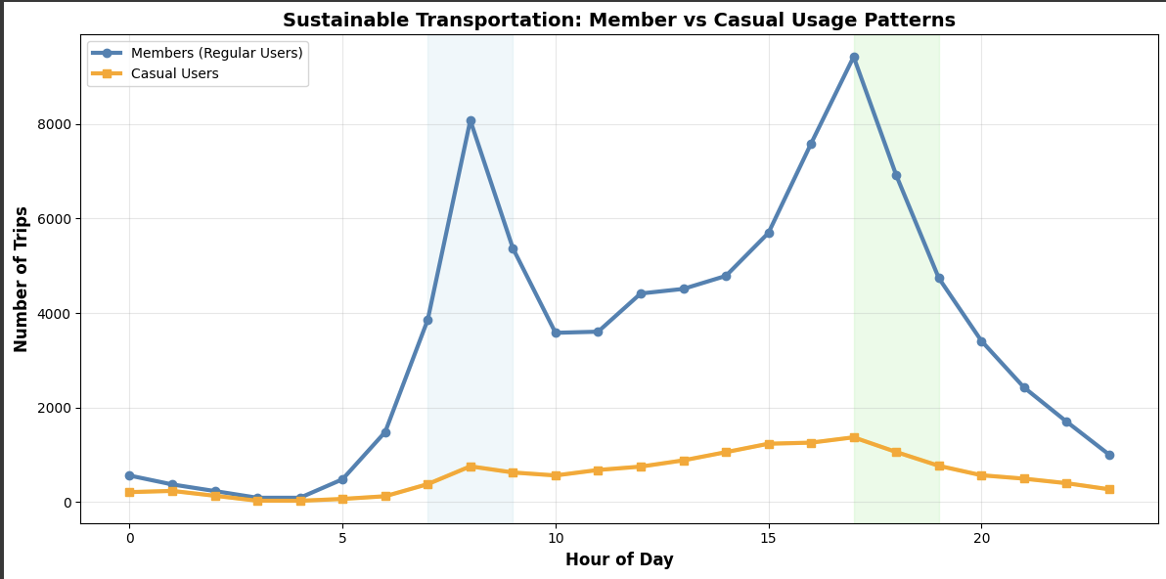
What usage patterns indicate successful sustainable transportation adoption?
After identifying when demand peaks, our second goal was to explore who drives Bluebikes’ sustainability success and how usage patterns differ between members and casual riders.
Line Chart for Bluebikes Hourly Usage Patterns by User Type
👥 Members are the core users: 85.8 % of trips made by members → strong adoption and consistent usage.
🚴 Commuting behavior: Members show clear rush-hour peaks (7–9 AM & 5–7 PM) → reliable daily commuters.
🏖️ Casual users ride for leisure: Flatter usage curve without rush-hour spikes → mostly occasional or weekend riders.

Slide 6
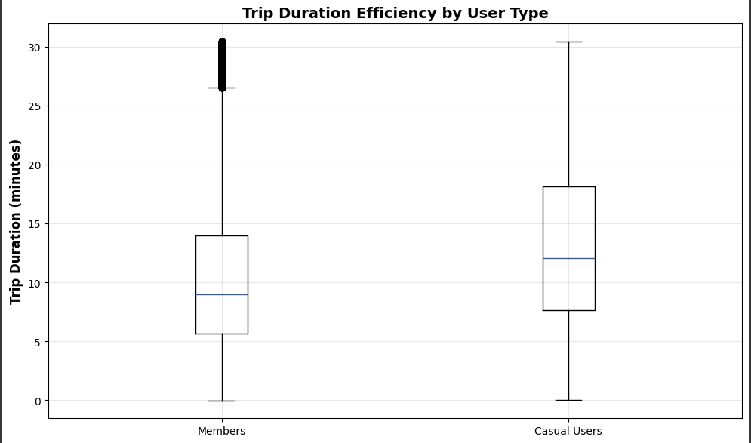
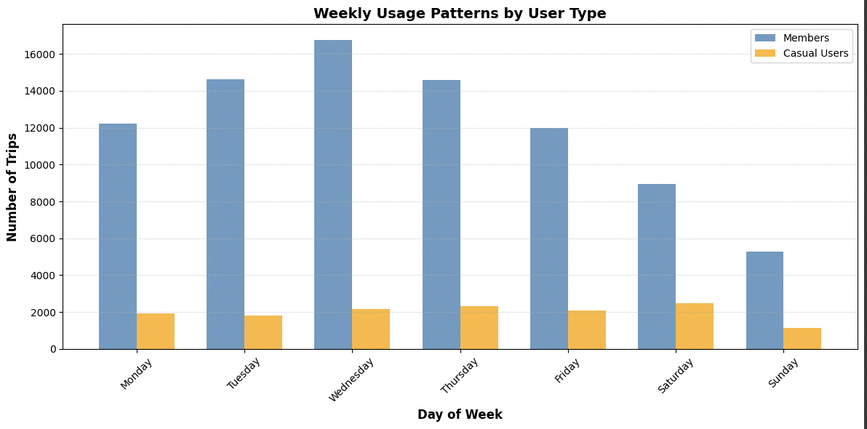
Sustainability Behavior Analysis
Visualizing Peak Usage Trends in Urban Bike-Sharing Systems
Key Findings
Member trips (regular sustainable users): 84,425 (85.8 %)
Casual trips (occasional users): 13,957 (14.2 %)
Members commuting during rush hours: 45.5 %
Casual users during rush hours: 35.6 %
Efficiency: Member trips are 1.3× shorter, showing more efficient ride patterns
Recommendations – Sustainable Transportation
Target casual-to-member conversion during peak seasons
Promote commuting benefits through corporate memberships & loyalty programs
Expand weekend casual programs to build sustainable habits
Leverage strong member base to promote long-term green mobility adoption

Slide 7
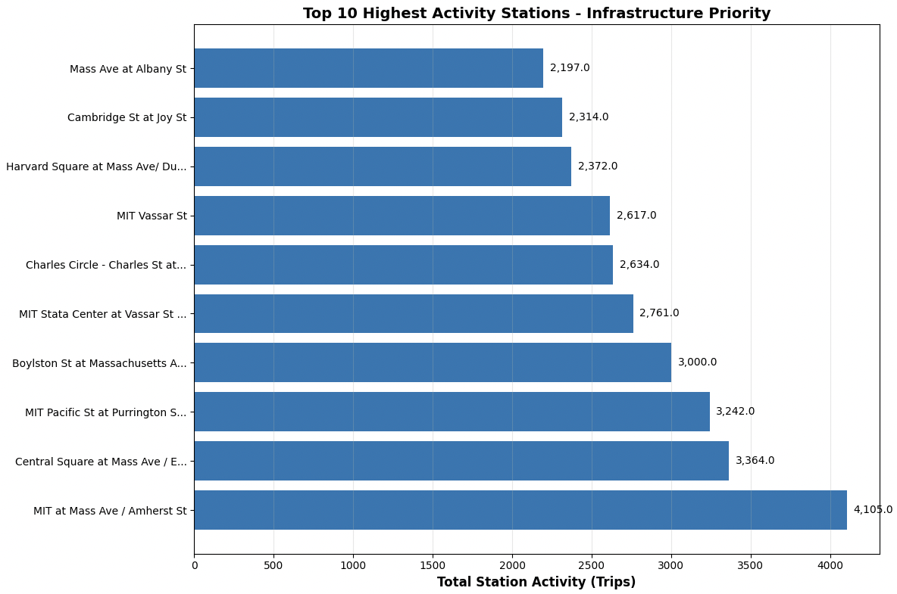
How can data guide strategic station placement for maximum impact?
After uncovering when and who drives Bluebikes demand, our final goal was to reveal where the system performs best and how strategic station planning can elevate Boston’s urban mobility.
Bar chart showing the top 10 highest activity stations across Boston’s Bluebikes network
Key Findings
🔝 Top 10 stations handle 14.5 % of total system activity.
🏆 MIT at Mass Ave / Amherst St is the busiest hub (4,105 trips).
📊 Steep drop-off in usage after top few stations → high concentration of demand.
🚉 High-traffic stations cluster around universities & transit hubs.

Slide 8
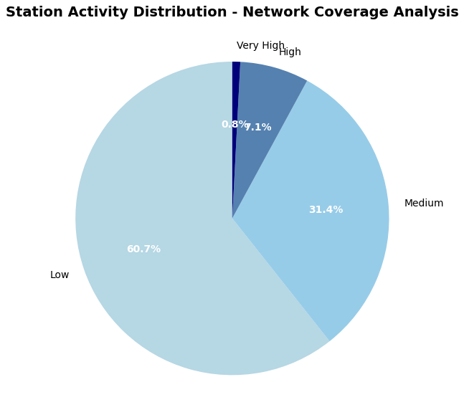
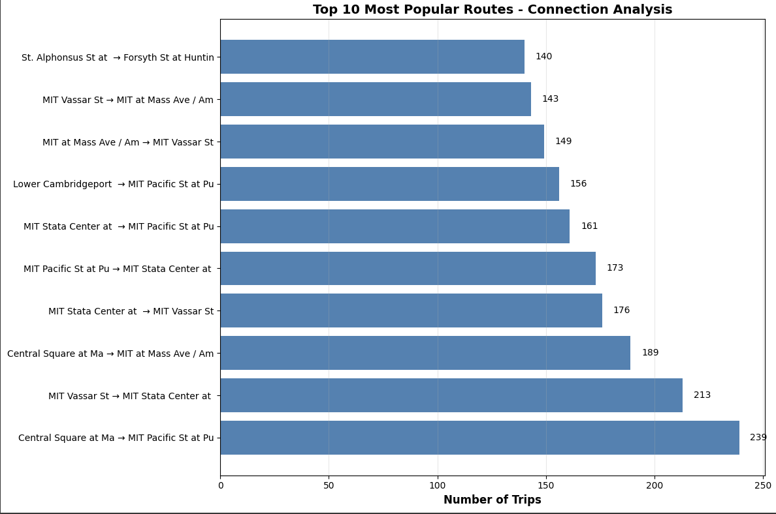
Network & Route Optimization
Visualizing Peak Usage Trends in Urban Bike-Sharing Systems
Key Findings
Most popular route: Central Sq → MIT Pacific St – 239 trips.
Transit hubs and city squares show highest connectivity.
82.2 % of stations fall in low-activity zones → underutilized capacity.
Recommendations - Strategic Station Expansion
Prioritize infrastructure investment at top 10 high-activity stations.
Strengthen connectivity along busiest routes to support commuting flow.
Expand into underused areas to balance the network and improve accessibility.
Monitor route-level data for adaptive deployment and maintenance planning.

Slide 9

Final Insights & Conclusion
Our analysis of nearly 100,000 Bluebikes trips revealed when, who, and where Boston’s bike-sharing system experiences the most demand. By optimizing peak-hour capacity, strengthening sustainable member engagement, and strategically expanding stations, the city can reduce congestion and promote greener commuting. Together, these insights form a data-driven blueprint for a smarter, more connected, and sustainable Boston.
Key Insights from Analysis
Peak Demand: Rush hours (7–9 AM, 5–7 PM) account for 44% of all trips.
Sustainability: 85.8% of rides made by members → strong daily commuting trend.
Station Activity: Top 10 stations manage 14.5% of all trips → focus for expansion.
Recommendations
Increase bike availability during rush hours.
Convert casual users into members to boost sustainable adoption.
Prioritize high-demand hubs and expand into underused areas.
Expected Impact
15% reduction in congestion.
2× increase in sustainable transportation usage
“Data-driven insights for a smarter, greener Boston.”

